Slide 1
Photometric image formation

Slide 2
Objectives
Effect of illumination and light source
Reflectance and shading problems
Optics: pinhole model

Slide 3
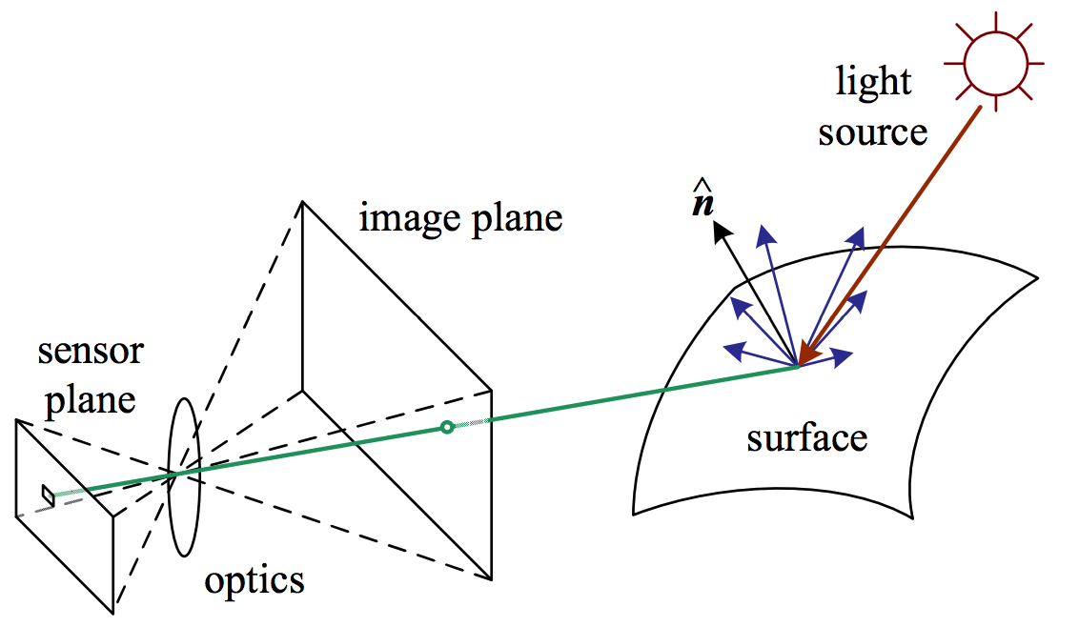
Photometric image formation
Photometry is the science of the measurement of light, in terms of its perceived brightness to the human eye.
Notes:
A simplified model of photometric image formation. Light is emitted by one or more light sources and is then reflected from an object’s surface. A portion of this light is directed towards the camera. This simplified model ignores multiple reflections, which often occur in real-world scenes.

Slide 4
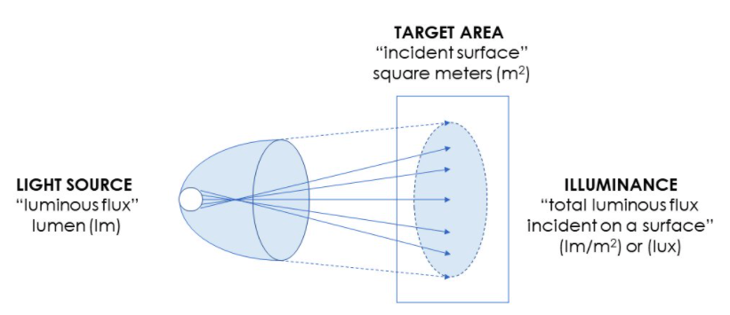
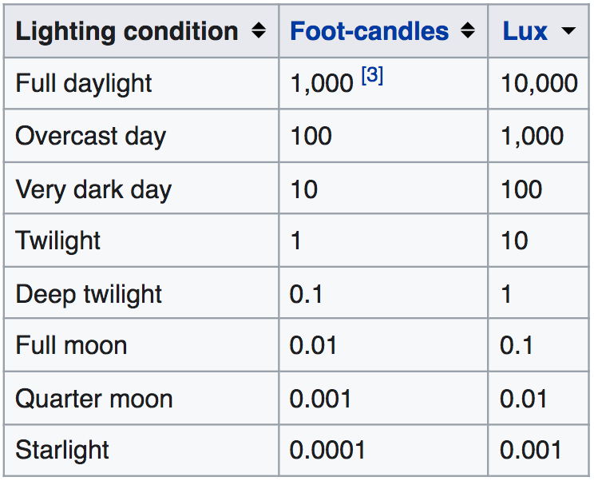
Illumination
Source of illumination--> any device serving as a source of visible electromagnetic radiation
Light source, light -->any device serving as a source of illumination
An “illimination model” describes inputs, assumption, and outputs used to calculate illumination(color/ brightness) of surface elements
Notes:
Illumination: chiếu sáng
Illuminance was formerly often called brightness, but this leads to confusion with other uses of the word, such as to mean luminance.

Slide 5
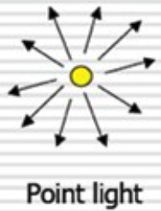
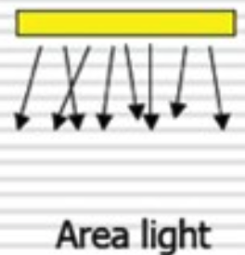
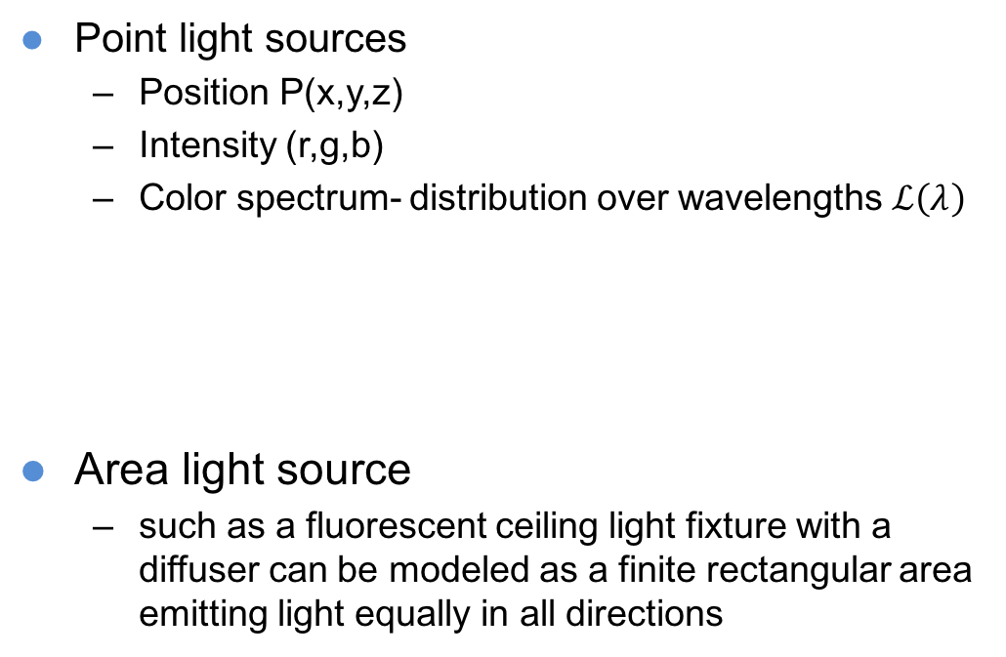
Light sources
Point light sources
Position P(x,y,z)
Intensity (r,g,b)
Color spectrum- distribution over wavelengths $ℒ\left(λ\right)$
Area light source
such as a fluorescent ceiling light fixture with a diffuser can be modeled as a finite rectangular area emitting light equally in all directions
Notes:
Area light source: giống như đèn huỳnh quang loại dài, phát ra ánh sáng

Slide 6
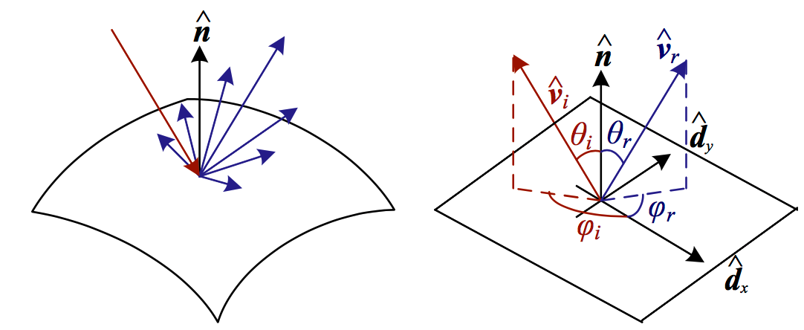
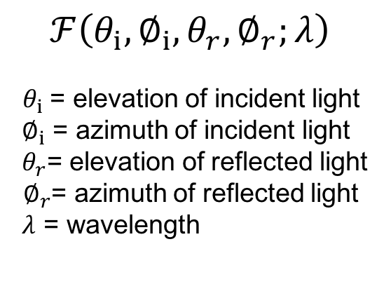
Reflectance and shading
When light hits an object’s surface, it is scattered and reflected.
The bidirectional reflectance distribution function (BRDF) describes the proportion of light coming from each incident direction that is redirected to each reflected direction, as a function of wavelength.
The BRDF is reciprocal (can exchange the incident and reflected directions)
$$ℱ\left(θ_{i},∅_{i},θ_{r},∅_{r};λ\right)$$
$θ_{i}$= elevation of incident light
${ ∅}_{i}$ = azimuth of incident light
${ θ}_{r}$= elevation of reflected light
$∅_{r}$= azimuth of reflected light
$λ$ = wavelength
Notes:
the BRDF is a four- dimensional function that describes how much of each wavelength arriving at an incident direction vˆi is emitted in a reflected direction vˆr

Slide 7



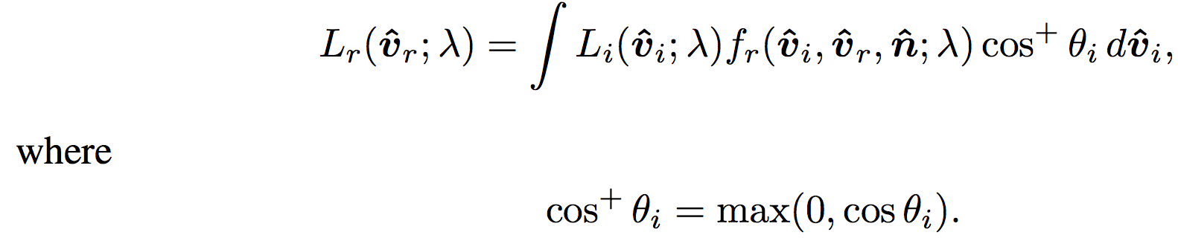
The BRDF
For isotropic surfaces:
To calculate the amount of light exiting a surface point p in a direction
We integrate the product of the incoming light with the BRDF
Taking into account the foreshortening factor cos+ θi, we obtain
Foreshortening effect due to surface orientation
Notes:
the BRDF is a four- dimensional function that describes how much of each wavelength arriving at an incident direction vˆi is emitted in a reflected direction vˆr

Slide 8
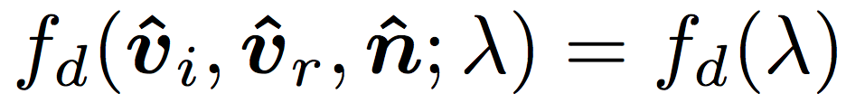
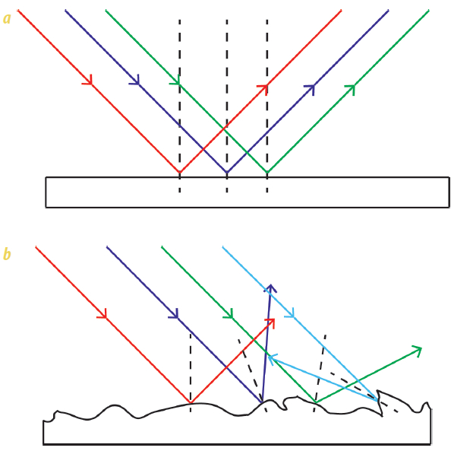

Diffuse( Lambertian, Matte) reflection
The diffuse component of the BRDF scatters light uniformly, giving rise to Lamberitan shading.
Light is scattered uniformly in all directions
The amount of light depends on the angle between the incident light direction and the surface normal.
Lambert’s cosine law :
where
Notes:
Diffuse or Lambertian Reflection : phản xạ khuyết tán

Slide 9
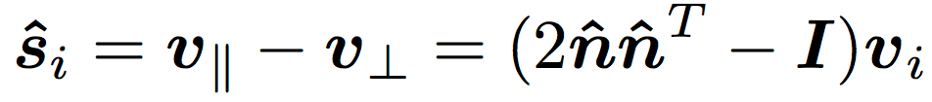
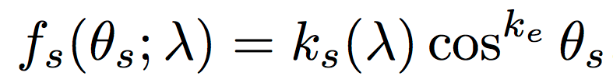
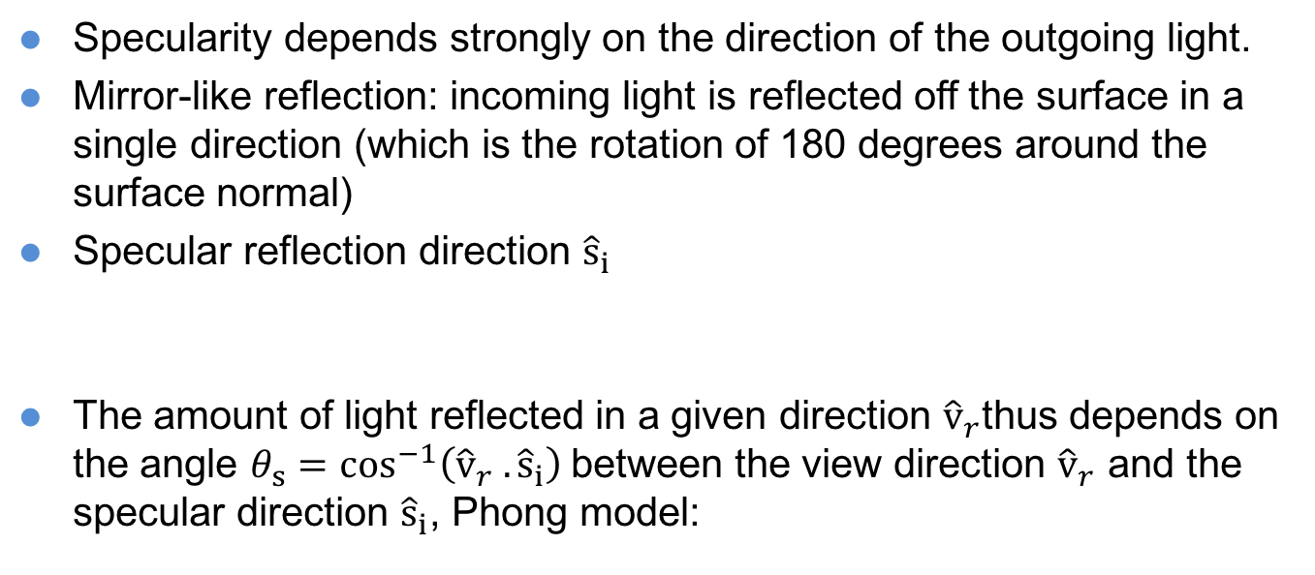
Specular reflection
Specularity depends strongly on the direction of the outgoing light.
Mirror-like reflection: incoming light is reflected off the surface in a single direction (which is the rotation of 180 degrees around the surface normal)
Specular reflection direction ${\hat{s}}_{i}$
The amount of light reflected in a given direction ${\hat{v}}_{r}$thus depends on the angle $θ_{s}=\cos^{−1}\left({\hat{v}}_{r} .{\hat{s}}_{i}\right)$between the view direction ${\hat{v}}_{r}$ and the specular direction ${\hat{s}}_{i}$, Phong model:
Colour
Colour

Slide 10

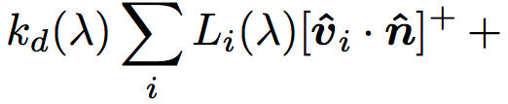
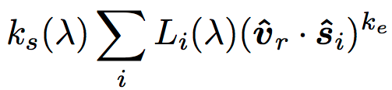
Phong Shading
The full Phong model combines diffuse and specular components contributed by the main illuminant with an ambient term that attempts to account for all other light incidents upon the surface from other parts of the scene (sky, walls, etc.).
Ambient light
Diffuse Reflectance
Specular Reflectance
Notes:
Phong: Bùi Tường Phong( 1942-1975)

Slide 11
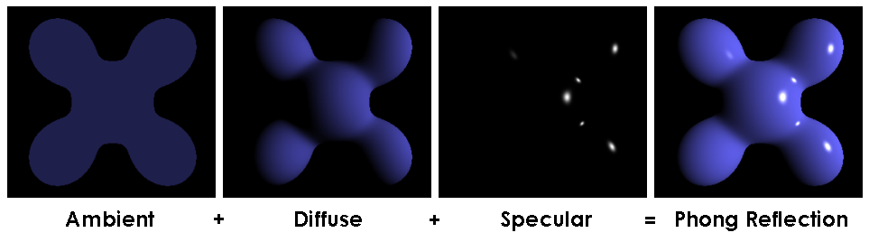
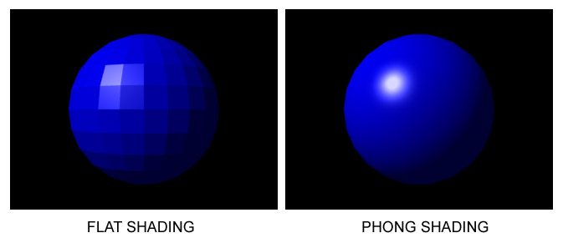
Phong Shading
Phong reflection model
Phong interpolation
Notes:
Phong: Bùi Tường Phong( 1942-1975)
Thể hiện công thức tính Phong: ánh sáng ở đây là ánh sáng trắng, màu xung quanh(ambient) và màu khuếch tán (diffuse) đều là xanh nước biển, và màu phản chiếu (specular) là màu trắng - phản chiếu một phần nhỏ của ánh sáng chiếu vào bề mặt của quả cầu
Phương pháp nội suy thường được gọi là Nội suy Phong (Phong interpolation). Phương pháp này còn được biết đến là phương pháp thắp sáng mỗi điểm ảnh (per-pixel lighting).

Slide 12
Ray Tracing
The Phong model assumes a finite number of discrete light sources.
Light emitted by these sources bounces off the surface and into the camera.
In reality, some of these sources may be shadowed by other objects, and the surface is generally also illuminated by inter-reflections (multiple bounces)
Two methods have traditionally been used to model such effects
If mostly specular, use ray tracing→ Follow each ray from camera across multiple bounces toward light sources
If mostly matte, use radiosity→ Model light interchanged between all pairs of surface patches, and then solve as linear system with light sources as forcing function.
Phong interpolation

Slide 13
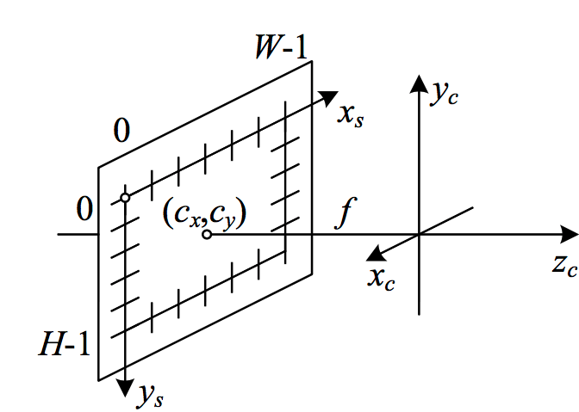
Optics
Simplified camera intrinsics showing the focal length f and the optical center (cx,cy). The image width and height are W and H.
Once the light from a scene reaches the camera→ it must still pass through the lens → reaching the sensor (analog film or digital silicon)
Notes:
Optics

Slide 14
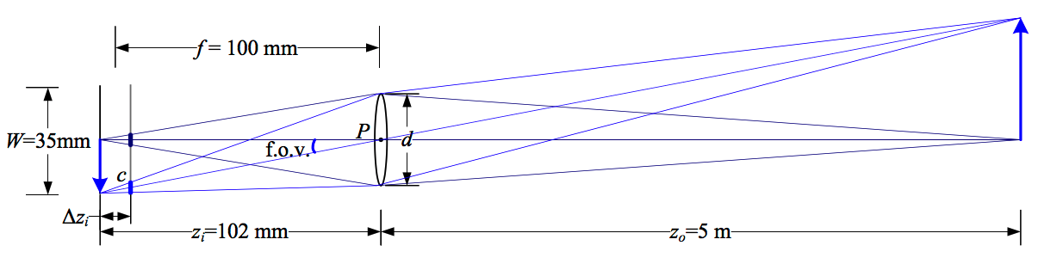
Thin Lens model
F = focal lenght
W = sensor width
Z0 = distance from optical center to object
Z1 = distance from optical center to where focused image of object is formed
d = aperture
c = circle of confusion
Notes:
Optics

Slide 15
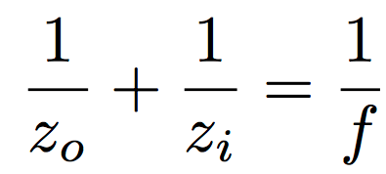
Lens Equation
F = focal lenght
W = sensor width
Z0 = distance from optical center to object
Z1 = distance from optical center to where focused image of object is formed
d = aperture
c = circle of confusion
Notes:
Optics

Slide 16
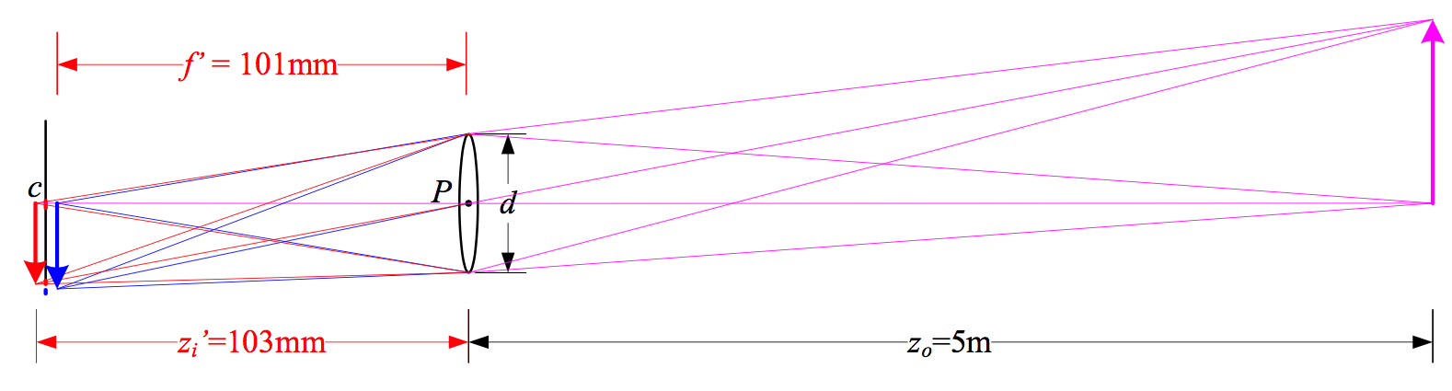
Chromatic aberration
Index of refraction of glass varies slightly as a function of wavelength.
As a result, different wavelengths focus at slightly different distances.
To reduce aberrations, most photographic lenses are compound lenses using multiple elements.
Notes:
OpticsIn a lens subject to chromatic aberration, light at different wavelengths (e.g., the red and blur arrows) is focused with a different focal length f ′ and hence a different depth zi′, resulting in both a geometric (in-plane) displacement and a loss of focus.
Chromatic aberration : quang sai- Trong quang học, quang sai màu, còn được gọi là biến dạng màu sắc và bệnh sắc tố màu, là sự cố thấu kính không thể tập trung tất cả các màu vào cùng một điểm. Đó là do sự tán sắc: chiết suất của các thành phần thấu kính thay đổi theo bước sóng ánh sáng

Slide 17
Summary
Effect of illumination and light source
Reflectance and shading problems
Optics: pinhole model

